Slide 1
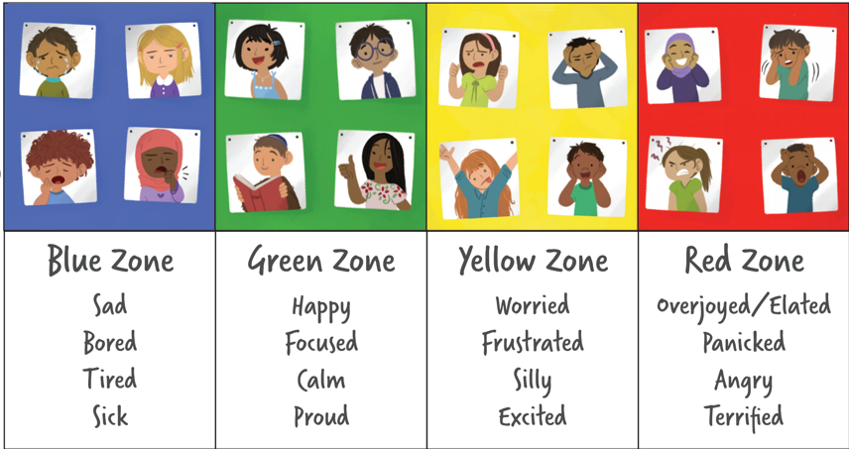
The Zones of Regulation

Slide 2
Session aims:
Overview of the Zones of Regulation
Explore self regulation and its importance
Tools we use in school
Share practical strategies

Slide 3
Our emotions can be divided into four colored zones:

Slide 4
What are the Zones of Regulation?
It teaches pupils:
Vocabulary of emotional terms
How to recognize their own emotions
How to detect the emotions of others (read others’ facial expressions)
What may trigger certain emotions
How others may interpret their behaviour
Problem solving skills

Slide 5
Why use the Zones of Regulation?
Provides a common language to discuss emotions – a language that is non-judgemental.
The Zones of Regulation is simple for children to understand but is helpful for all!
The Zones teach healthy coping and regulation strategies.

Slide 6
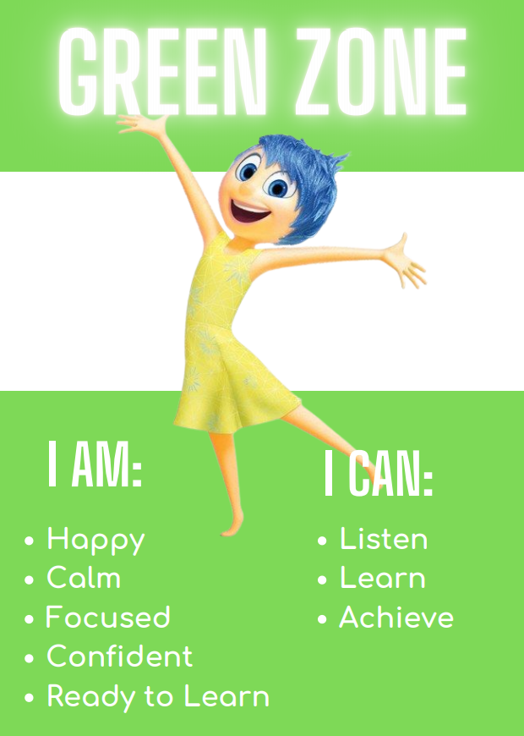
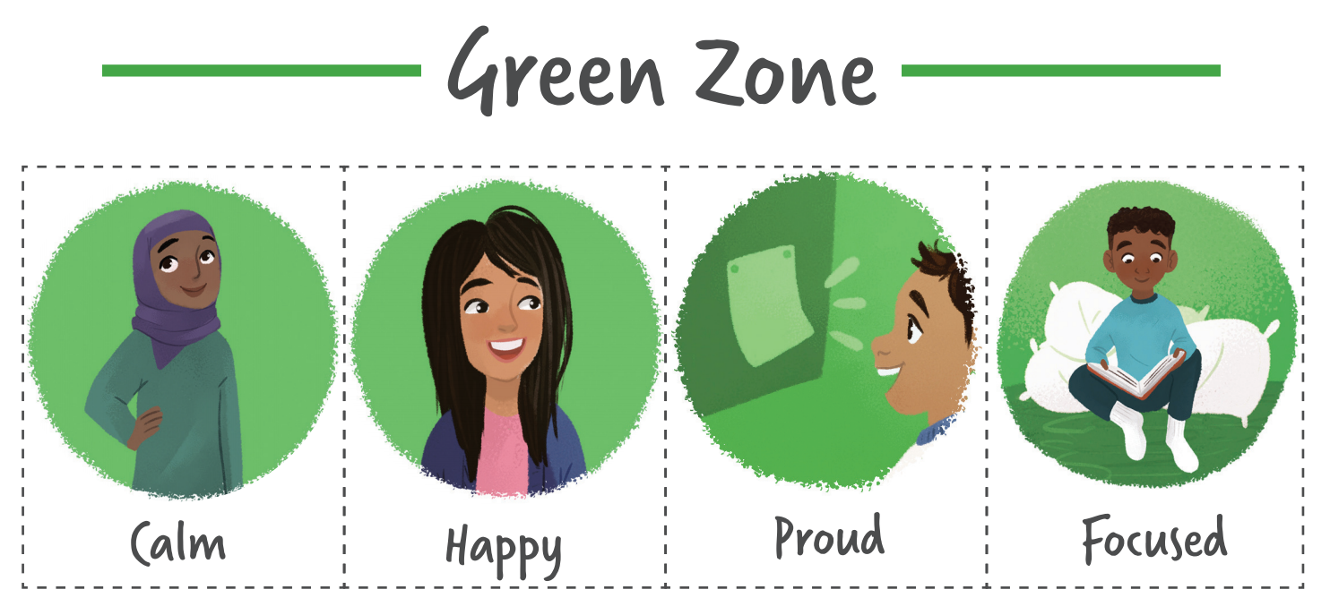
The Green Zone, like a green light, is when you are “good to go.” If you are in the Green Zone, you may feel happy, calm, and focused.

Slide 7
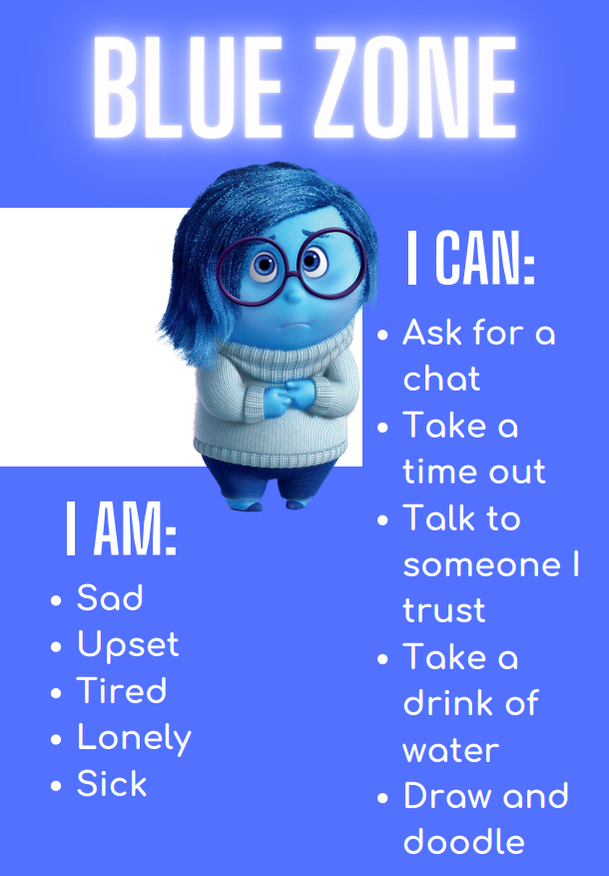
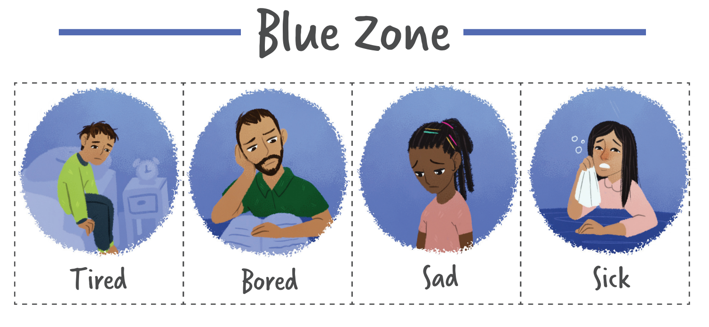
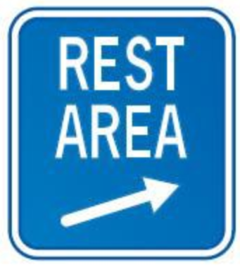
When you’re in the blue zone, your body is
running slow, such as when you are tired, sick,
sad or bored.

Slide 8
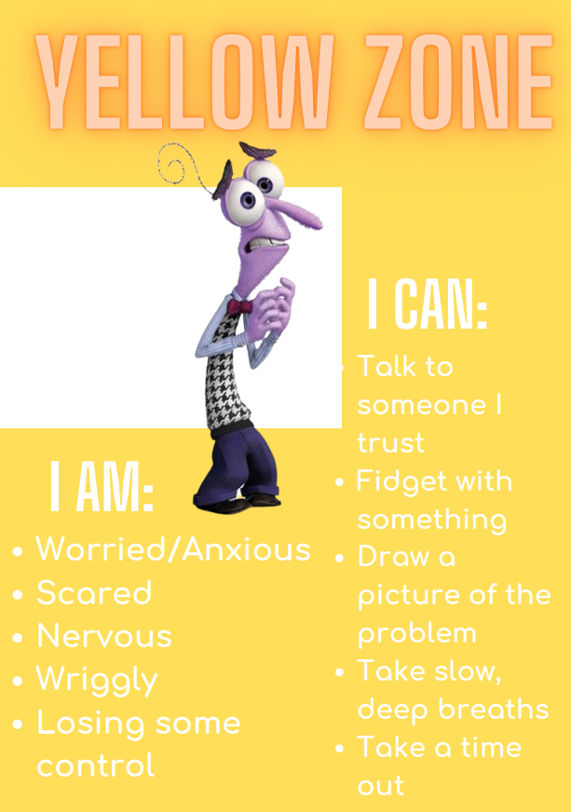
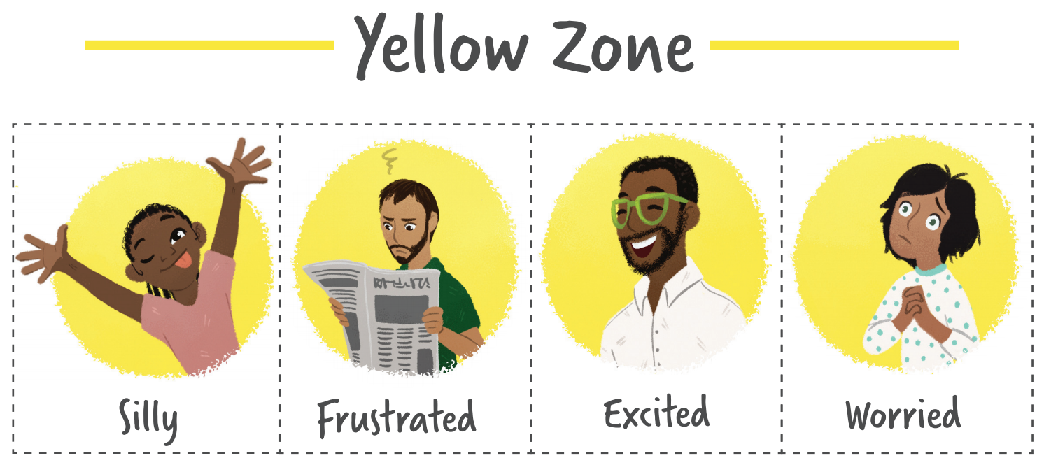
The yellow zone describes when you start to lose control, such as when you are frustrated, overwhelmed, silly, wiggly, excited, worried, anxious or surprised. It is a good idea to use caution when you are in the yellow zone.

Slide 9
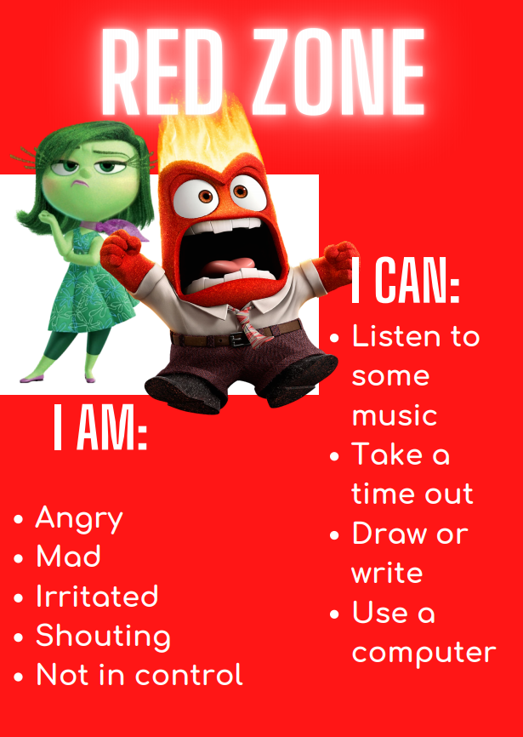
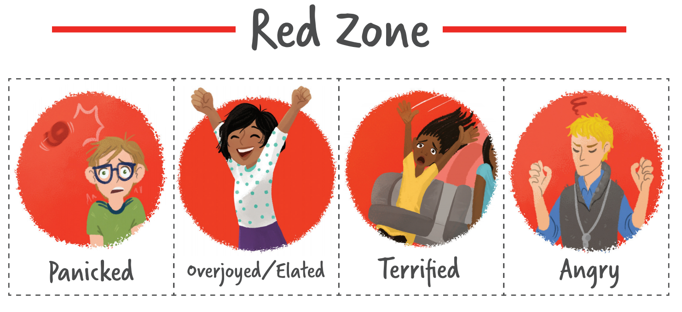
The red zone is reserved for extreme emotions like terror, uncontrolled anger, and aggression. When you are in the Red Zone, you are out of
control, have trouble making good decisions, and must STOP to regulate.

Slide 10
What is self-regulation?
The skill to acess, change and direct how emotions are revealed behaviourally in socially adaptive ways.
Encompasses:
• Self-control
• Resilience
• Self-management
• Anger management
• Impulse control
• Sensory regulation

Slide 11
Why is it important to self-regulate?
A person who can self regulate is able to:
remain CALM AND ORANISED in a stressful situation.
(Executive Functions)
cheer themselves up after a disappointment.
(Emotional Regulation)
knows when they are experiencing sensory overload and can make adjustments.
(Sensory processing)
Understands when it is appropriate to cheer and shout and when to be quiet.
(Social cognition)

Slide 12
The Zones of Regulation aims to teach children strategies to help them cope with these feelings so they can get back to feeling calm and ready to learn. These coping strategies are called ‘self-regulation’.

Slide 13
What you can do at home
We would really like for children to be able to continue to practice using their Zones of Regulation to manage their feelings at home.
• Encourage everyone at home to check which Zones they are in across the day – grown-ups included!
• Use the language of Zones to check in with your child ‘I can see you’re in the green zone because you are calm and eating really nicely at the table’. Or when they are getting overexcited/ upset ‘I can see you’re in the yellow zone, let’s use a strategy’
• Make a family toolbox full of strategies to move between the zones to use at home and pop it on the fridge to remind you all to use your tools

Slide 14
Tools you can use
Designated calm area
Weighted blanket or soft blanket
Playdough
Stress ball
Favourite book or a book about feelings
Colouring book or paper and coloured pencils
Come up with ideas together that can be used at home

Slide 15
Tools we use in school
In school each class has its own check in area where pupils can check in throughout the day, calm kits that have different strategies that can be used depending on what zone pupils are in and calm corners that pupils can use when needed.

Slide 16
Tools we use in school
Activate (tired, passive, disengaged)
Fidget Tracks, Movement Cards, Yoga Movements
Refocus (can be given when working with sensory input - busy hands support focused minds)
Squishy things, Blue tac, Marble mover
Calm (feeling angry, high emotion)
Colouring/Doodles, Breathing techniques

Slide 17
Thank you for coming

